Slide 1
Customer Sales & Behavior Insights Dashboard
Data Analysis Project(Istanbul Shopping Malls)

Slide 2
Project Overview
The dataset contains information from 10 shopping malls
in Istanbul covering the years 2021 to 2013. The objective is to
visualize the data to derive actionable business insights.

Slide 3
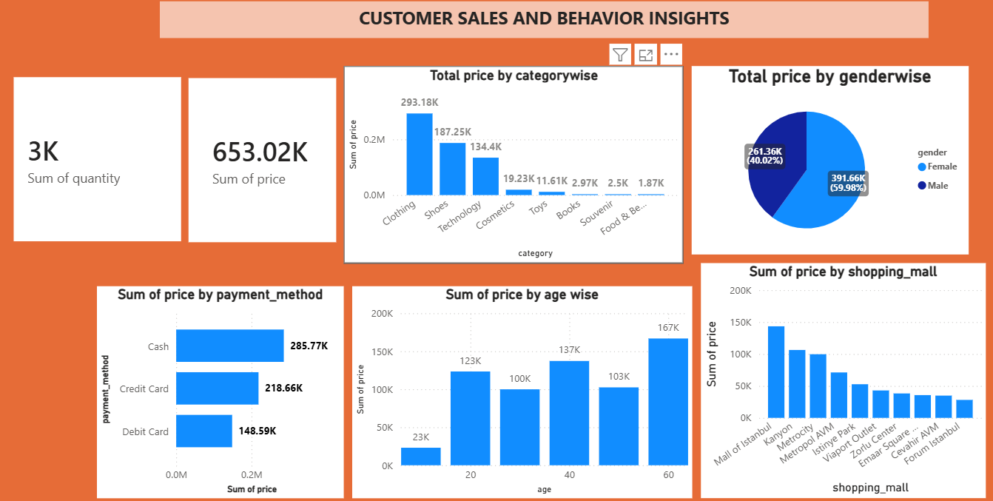

Slide 4
Key Insights & Suggestion
Top Categories:- clothing and shoes drive higher sales.
Suggestion:- Increase stock of these categorys and Runs promotion for top items.
Payment Methods :- customer mostly prefer cash, credit card and debit card.
Suggestion:- Offer cashbacks and smooth checkout for these popular options.
Customer Demography:- Specific age groups and locations bring more footfall.
Suggestion:- Target marketing campaigns towards these core segments.

Slide 5
Conclusion
Data-driven decisions, such as effective stock management and targeted
marketing, will help the company maximize its revenue and customer satisfaction.

